Slide 1

Computational Project
End of Summer Presentation
Presenters: Anna L., Sahil P., Jason Z.
Supervisors: Pouriya and Andy
Principal Investigator: Keith Pardee

Slide 2
Introduction
Goal of the project
Machine Learning guided design & biosimilar peptide prediction
Construct automated pipeline for data processing
Perform computational evolution with completed pipeline (later stages)
GitHub repository contains
Data
Intermediate & final results produced by pipeline
Program scripts for automation
Notes:
Mention the general outline
Introduction and software used
Cost of running
Machine Learning methodology

Slide 3
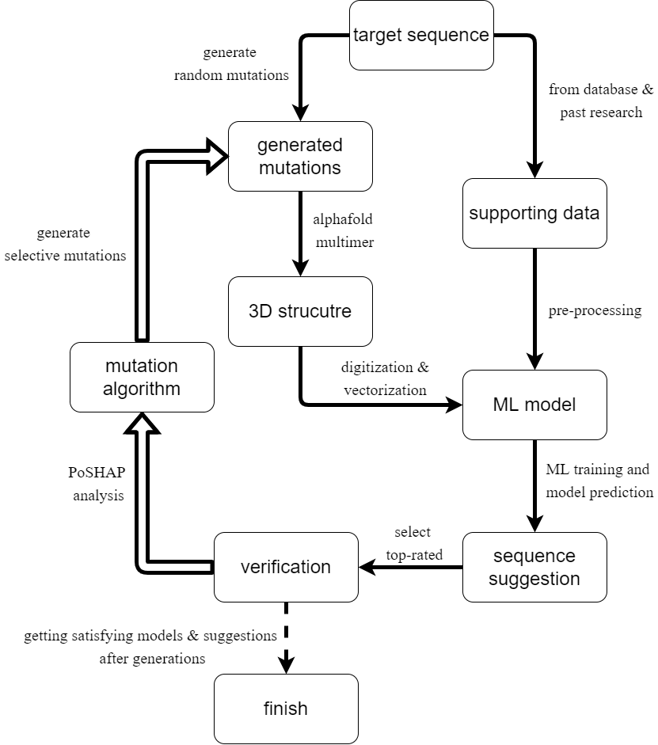
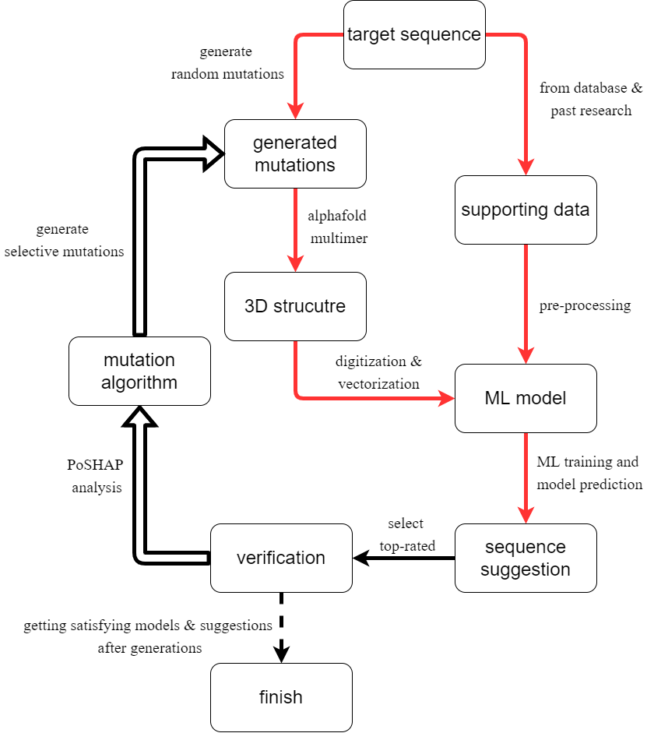
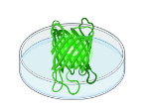
Project infrastructure
Initial in silico sequence data processing flow highlighted in red (used published dataset instead of generated mutations)
‘Feedback loop’ with wet lab validation

Slide 4
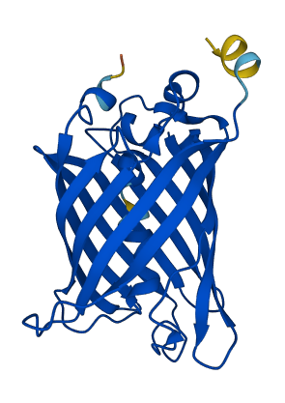

Why GFP?
Availability of data
109 high brightness sequences
From 44,000 mutations
Easy to verify
Observable fluorescence
Indicator can be quantified
Utilize wet lab resources from our lab
Relatively short sequence length (238)
Less time for AlphaFold prediction
Focus on mutations within GFP11

Slide 5
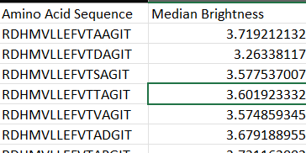
Data selection and interpretation
Data from Sarkisyan, K., Bolotin, D, et al, 2016 on Aequorea victoria (avGFP) Green Fluorescent Protein. Local fitness study of GFP at large scale by random mutagenesis.
Extracted only mutations that lies on the GFP-11 encoding region, single or multiple substitution mutation (over all length remains the same)
Our final data contains 109 amino acid sequences of GFP mutation with log-brightness
Log-brightness value < 3.0: the sequence fluorescent 5 times less intense than the wild type [1]
Log-brightness value > 3.0: considered as fluorescent/ functional for our purpose
Citation:
[1] Sarkisyan, K., Bolotin, D., Meer, M. et al. Local fitness landscape of the green fluorescent protein. Nature 533, 397–401 (2016). https://doi.org/10.1038/nature17995
[2] Bolotin, Dmitry (2016): Local fitness landscape of the green fluorescent protein. figshare. Dataset. https://doi.org/10.6084/m9.figshare.3102154.v1
Notes:
The data is wet lab validated

Slide 6
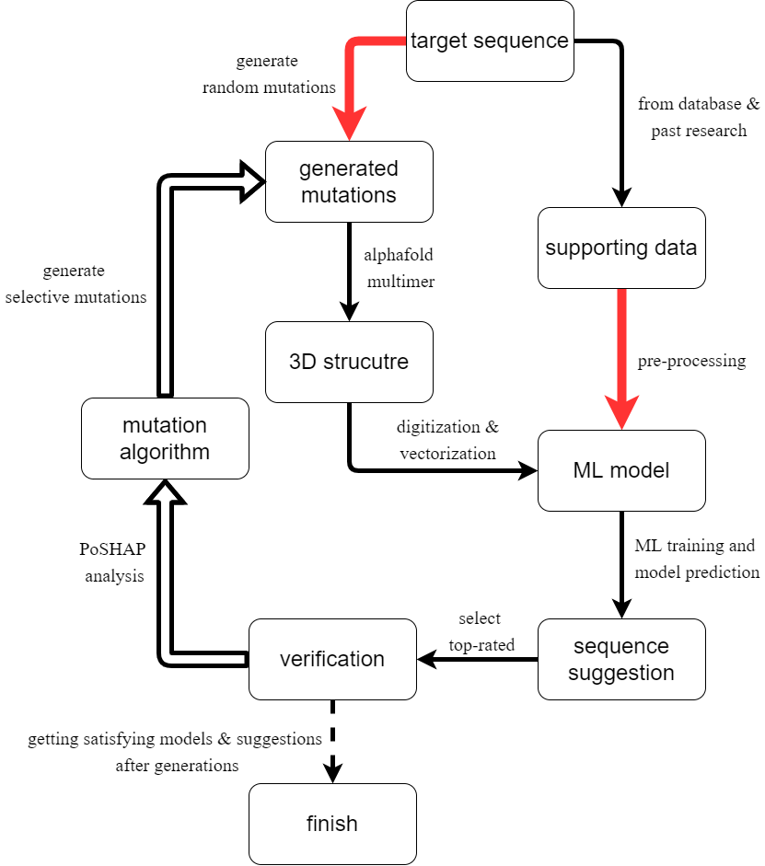
Why focus on GFP11 mutations?
Reduce mutation range
Friendly to wet-lab verification
Reduce AlphaFold runtime
Notes:
The split protein system between 1-10 and 11 is established.

Slide 7
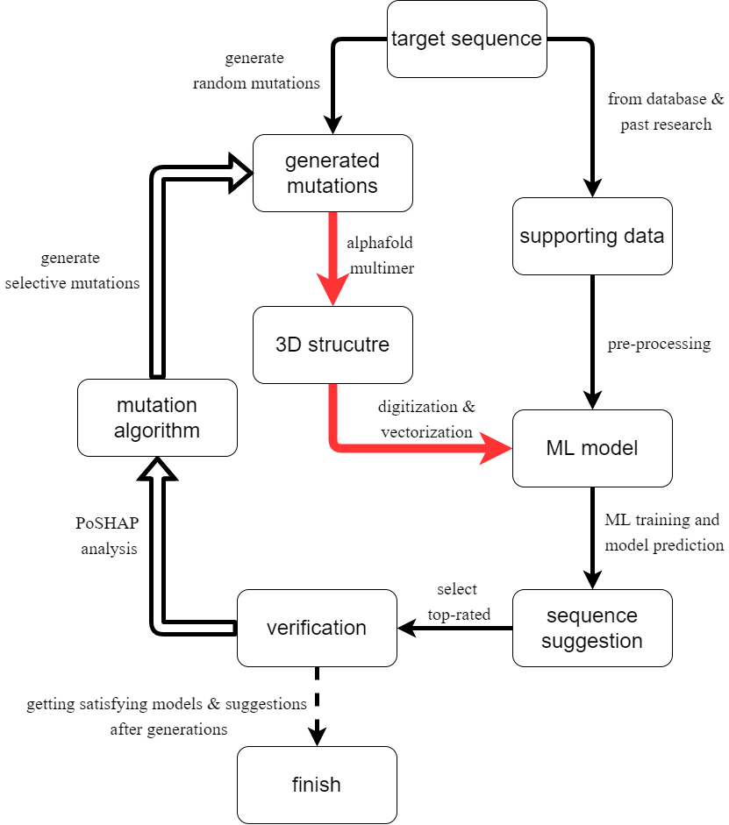


From Structure to Training Data
Alphafold multimer
Run on cloud/ server
Structural prediction of GFP1-10 and mutated GFP11
pdb files as output
PyRosetta
Run with python code on local machine/ cloud (use student account for free access)
Structural analysis of energy level, pdb file as input
parameter extraction
SpServer
Run with python code on local machine/ cloud (open source)
Quality analysis of structural fold and protein interaction
parameter extraction

Slide 8
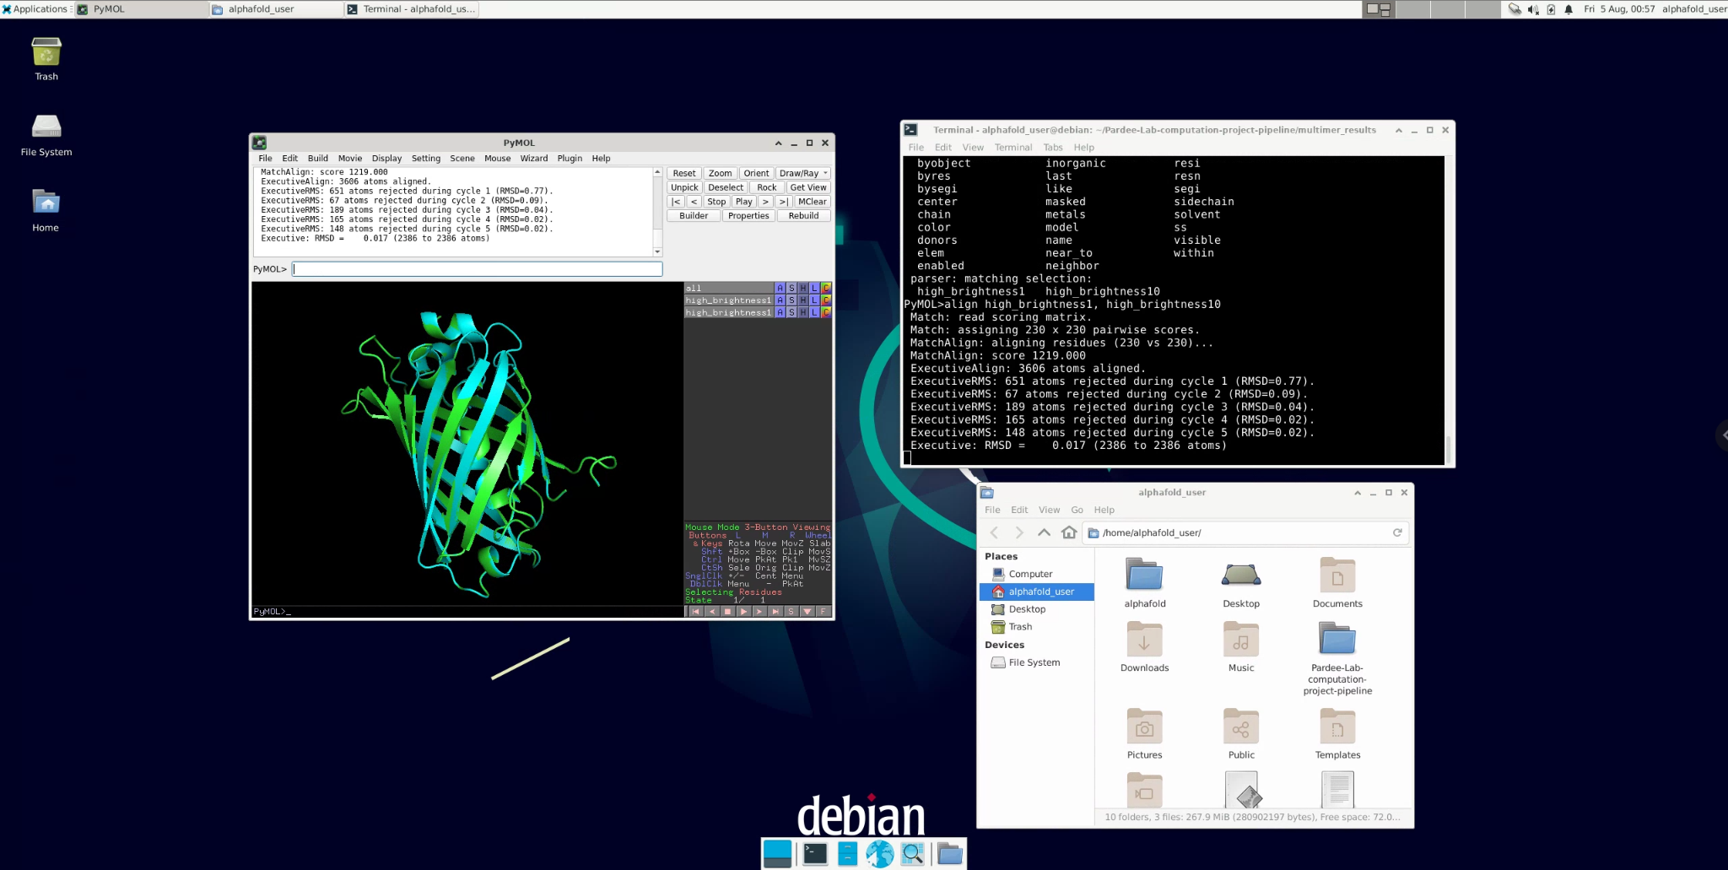
Expand on AlphaFold supported by cloud server

Slide 9
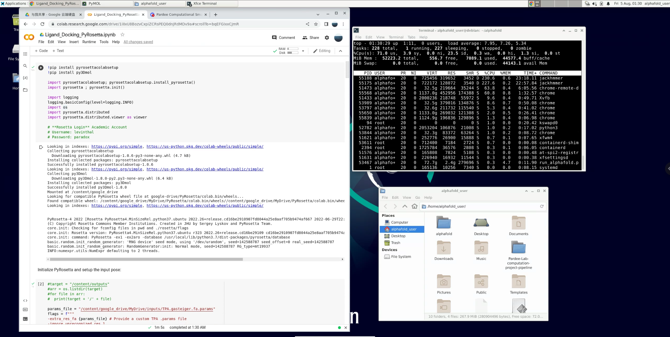
Related tools and web browser available

Slide 10
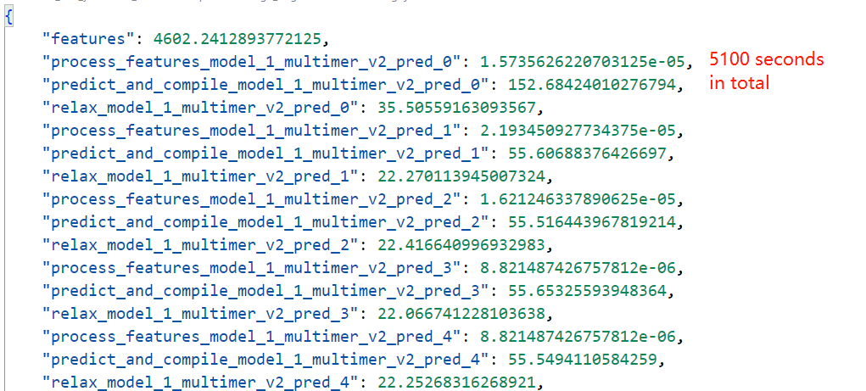
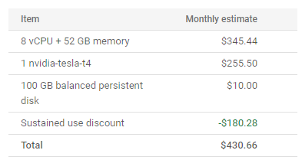
Performance & Expense
$1.2 per hour, and $900 per month
80 minutes for full GFP in multimer
15 minutes for GFP11
Output pdb files storing predicted structures
Budget plan and warning available
Open to computation power increase

Slide 11
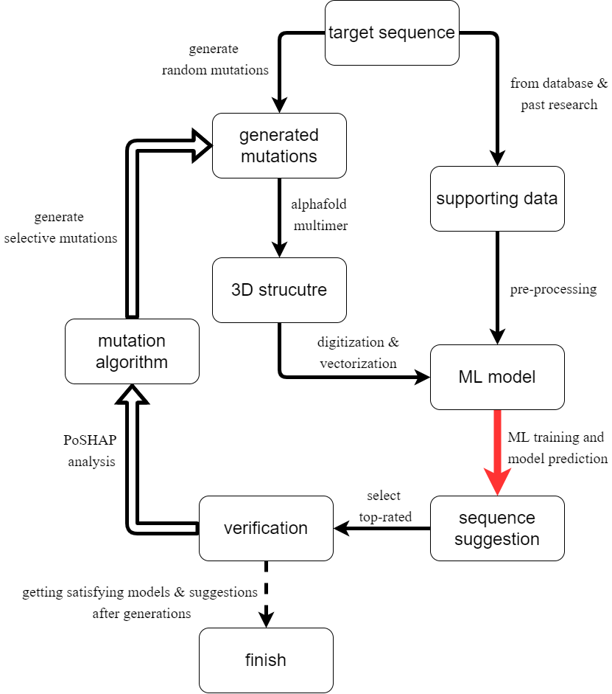
Machine Learning Model Construction

Slide 12
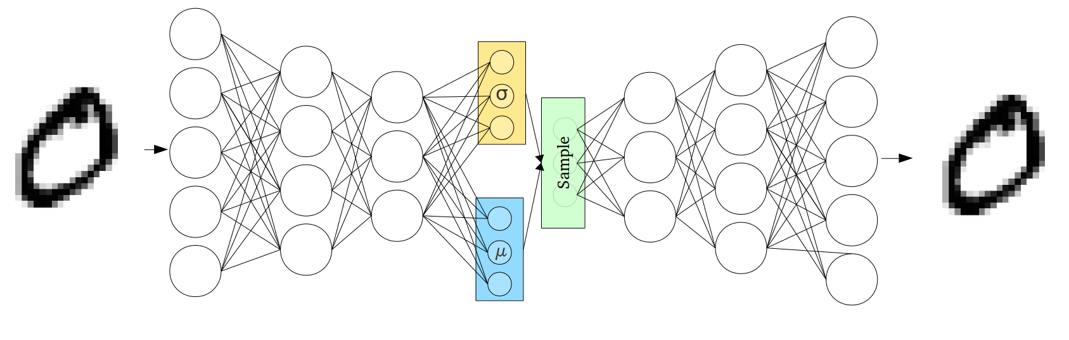
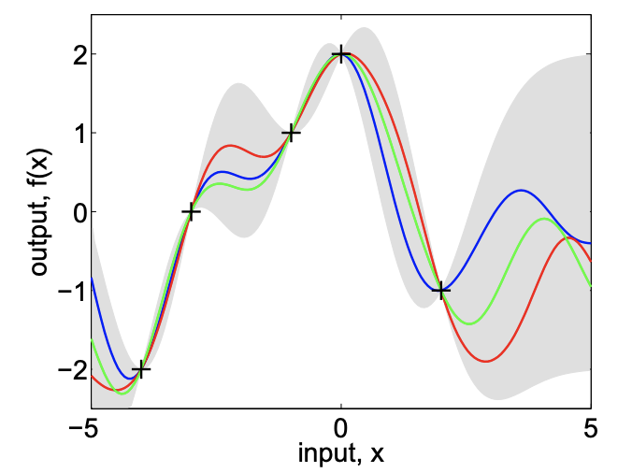
Main Machine Learning Model Types
Variational Autoencoder
Input → Smaller Form → Reconstruction of Input
Why? We want to compress our amino acid sequence into a smaller form in a continuous space, and give it a chemical representation (functional similarity might imply chemically similarity)
Gaussian Process
Regression with distributions at each point
Why? We want to have some confidence about our choice of mutation

Slide 13
High Level View of the Machine Learning Algorithm
Amino Acid Sequence
Chemical Representation
AlphaFold Prediction
Global Representation
PPI Scores
Final Continuous Representation
GFP Brightness

Slide 14
Chemical Representation/Encoding
Amino Acid Sequence
Amino Acid → Chemical Matrix → Compressed Chemical Representation
Each amino acid turns into a vector of chemical properties (forming a matrix)
Matrix of the sequence is then compressed into a vector form (using machine learning)
Using a VAE to make the space continuous, and give chemical representations to amino acid sequences
Chemical Representation
AlphaFold Prediction
Global Representation
PPI Scores
Final Continuous Representation
GFP Brightness
Each amino acid has various chemical properties, and by having a representation of the amino acid sequence based on the chemical properties, we can determine which other mutations might be functionally similar based on chemical similarities

Slide 15
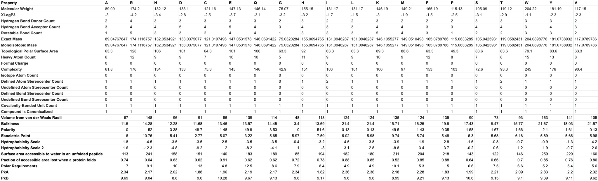
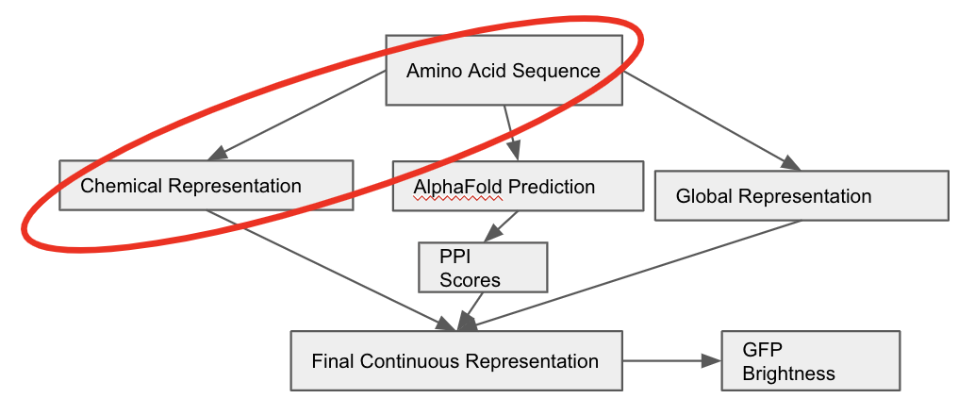
Example Chemical Encoding
Amino Acid Matrix Representation
R → [174.2, -4.2, 4, 4, 5, 174.11, 174.11, …]
D → [133.1, -2.8, 3, 5, 3, 133.04, 133.04, …]
… → …
Amino Acid Sequence of GFP11 (RDHMVLQEFATAAGIT)

Slide 16
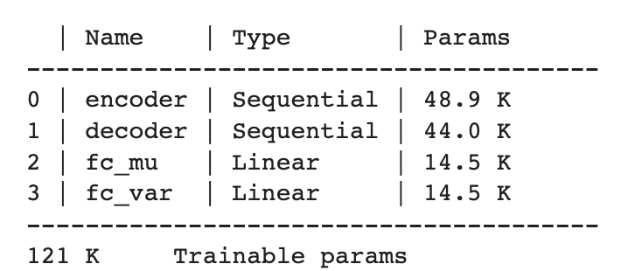
Example Matrix Compression (using a VAE with 120k+ Parameters)
AA Machine Learning Reconstruction Attempt
R → [178.2, -4.2, 4, 7, 5, 174.11, 179.11, …]
D → [133.9, -2.8, 20, 5, 6, 123.04, 133.04, …]
… → …
Smaller Vector Form
[x₁, x₂, …, x_{n}]
Learned Transformation
Learned Transformation
Amino Acid Matrix Representation
R → [174.2, -4.2, 4, 4, 5, 174.11, 174.11, …]
D → [133.1, -2.8, 3, 5, 3, 133.04, 133.04, …]
… → …
Kept for Later

Slide 17
Global Representation
Amino Acid Sequence
Amino Acid Sequence → Global Encoding Vector
By comparing it to a lot of other proteins, we can see if our mutated sequence follows “normal” patterns
Such an addition is based on a separate paper that found success in including information found from other proteins
Known patterns will have closer representations than obscure mutations that aren’t in the global database
Chemical Representation
AlphaFold Prediction
Global Representation
PPI Scores
Final Continuous Representation
GFP Brightness
In order to get some more information about our mutated sequence, we can compare it to a large database of known protein sequences and look for patterns

Slide 18
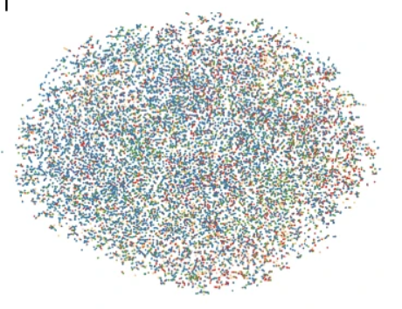
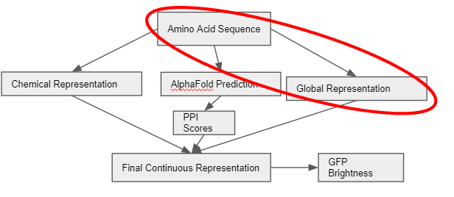
Global Encoding Example
Global Protein Space
Language Machine Learning Model
Encoded Representation
[y₁, y₂, …, y_{i}]
Language models are good at taking letters and their positions and assigning meaning to them
Ex) A model takes in a sentence and learns the sentiment (good/bad) of it
Amino Acid Sequence of GFP11 (RDHMVLQEFATAAGIT)

Slide 19
Protein-Protein Interaction Factors
Amino Acid Sequence
Amino Acid Sequence → AlphaFold → PPI Software → PPI Scores
The result is a bunch of quantities representing the likelihood of a protein binding to its target:
[z₁, z₂, …, z_{j}]
Chemical Representation
AlphaFold Prediction
Global Representation
PPI Scores
Final Continuous Representation
GFP Brightness
PPI’s try and predict whether or not a protein might bind with another, in this case GFP1-10 with GFP11. Such data has been shown to be a strong predictor of whether a mutated GFP11 might be successful.

Slide 20
Final Prediction Model (remove text)
Amino Acid Sequence
Combine Chemical Representation, PPI Scores, and Global Representation → Gaussian Process → Predicted Brightness
We have 3 branches of information to give meaning to the GFP11 sequence
A gaussian process will give a confidence interval of brightness of the mutated sequence
This will prevent us from spending wet lab resources on outlandish choices in mutations (which are expected given that we only have 100 wet lab data points)
Chemical Representation
AlphaFold Prediction
Global Representation
PPI Scores
Final Continuous Representation
GFP Brightness
We now combine all three branches of data into one large vector, and try to use all of that information to predict whether a certain mutation of GFP11 will work.

Slide 21
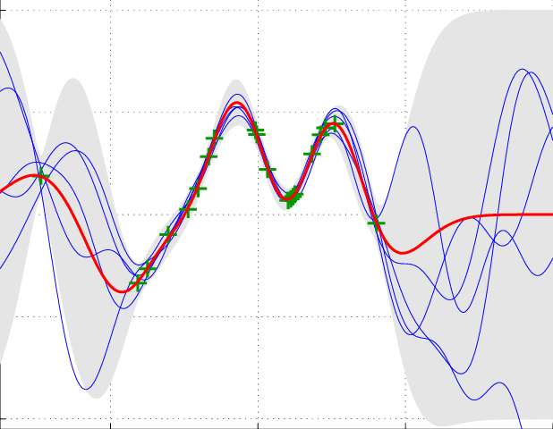
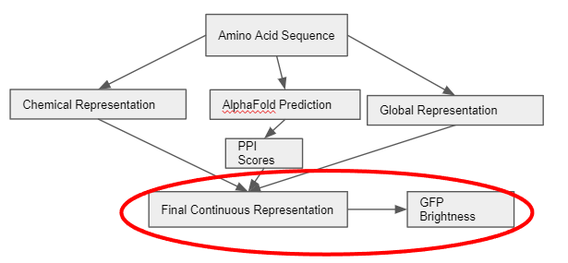
Final Prediction Model Example
Chemically Encoded Representation
[x₁, x₂, …, x_{n}]
Combined Representation
[x₁, x₂, …, x_{n}, y₁, y₂, …, y_{i}, z₁, z₂, …, z_{j}]
Expected Brightness and Confidence Interval
Global Encoded Representation
[y₁, y₂, …, y_{i}]
SPServer Data
[z₁, z₂, …, z_{j}]
Gaussian Process

Slide 22
Choosing Viable Mutations (Method 1)
In silico directed evolution
Generate a list of a couple million of random mutations
Predict the brightness of the mutations using the previously trained model
Keep the successful candidates and mutate them again
Aggregate a list of successful mutations and attempt them in the wetlab
Gaussian Process with Threshold
Mutated AA Sequences of GFP11
Predicted Successful Mutations of GFP11

Slide 23
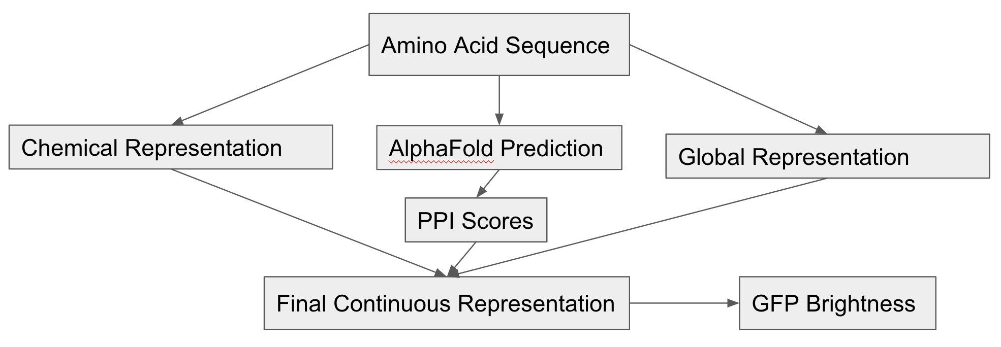
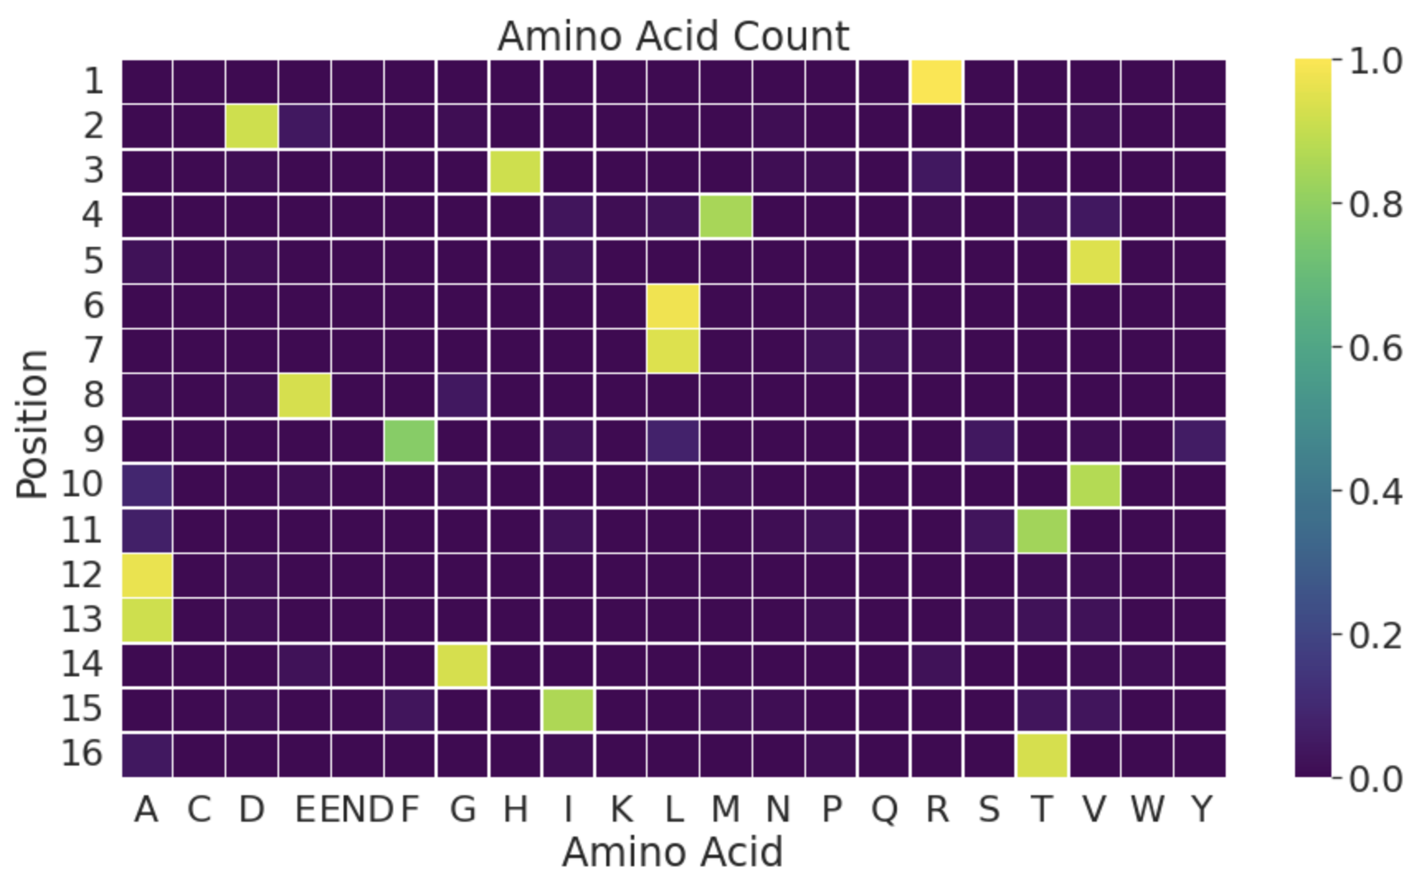
Choosing Viable Mutations (Method 2)
Published in a paper this year, researchers used a PoSHAP heatmap to outline which amino acids in certain positions might be problematic in the protein’s functionality
Given our lack of data, we can’t simply copy their model as we produce a very sporadic heatmap (as seen below) so we must use our own
We can put our model into PoSHAP, and make mutations based on the PoSHAP heatmap
Machine Learning Model
PoSHAP Heatmap

Slide 24
Current Machine Learning Progress
The chemical encoder is finished (though in need of editing)
SPServer and other PPI information included with the chemical representation
Intermediate analysis between PPI scores and GFP median brightness
Amino Acid Sequence
Chemical Representation
AlphaFold Prediction
Global Representation
PPI Scores
Final Continuous Representation
GFP Brightness

Slide 25
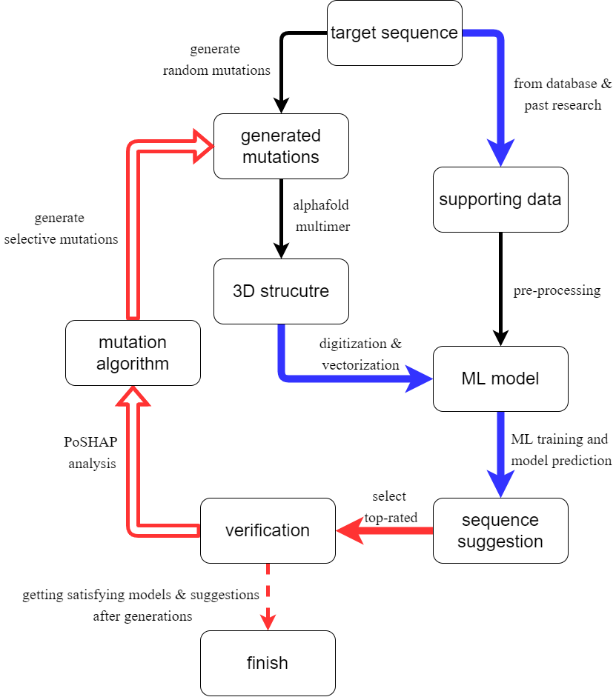
Conclusion and Next Steps
The proposed data processing pipeline and machine learning methods serve as a preliminary tool for protein functionality prediction in our lab
Finding alternative mutations based on only 100 wet lab data points could significantly reduce the time it takes to develop and discovery alternative viable proteins
Next Steps Could Include:
Proceed with wet lab validation for ML outputs of GFP11 sequences
Using another model to help generate more data to increase predictive accuracy
Changing the goal of model to generate alternatives that have significantly more mutations to create very different, yet still useable, proteins
Further expand on other peptides/proteins e.g. insulin

Slide 26
Any questions?
Thank you Pouryia, Andy, Keith, Alex, Jennifer, Iwe, and everyone in the lab!

